Slide 1
GRAPHIC DESIGN PROJECT PROPOSAL INFOGRAPHICS
Here is where this template begins

Slide 2
ABOUT GRAPHIC DESIGN PROJECT PROPOSAL INFOGRAPHICS
This template contains an assortment of complementary infographic resources for the Graphic Design Project Proposal presentation
These infographics are adapted to the style of the aforementioned presentation, so you can insert them easily and have them completely integrated at once. You just need to do the following:
Select the element that you want to copy
Right-click and choose “Copy”
Go to the slide where you want the element to appear
Right-click and choose “Paste”

Slide 3
GRAPHIC DESIGN PROJECT PROPOSAL INFOGRAPHICS
MARKET B
Saturn is a gas giant and has several rings. This planet is composed of hydrogen and helium
80%
20%
MARKET A
Mercury is the closest planet to the Sun and the smallest one in the entire Solar System

Slide 4
GRAPHIC DESIGN PROJECT PROPOSAL INFOGRAPHICS
Mercury is the smallest planet in the sky
Mars is actually an extremely cold place
Venus is the second planet from the Sun
DEFINE
DESIGN
EVALUATE
ANALYZE
IMPLEMENT
Saturn is a gas giant and has several rings
Jupiter is the biggest planet in the sky

Slide 5
GRAPHIC DESIGN PROJECT PROPOSAL INFOGRAPHICS
LISTENING
TEAMWORK
Mercury is the smallest planet of them all
Venus is the second planet from the Sun
ANALYSIS
GRAPHIC DESIGNER
LEADERSHIP
Saturn is a gas giant and has several rings
Earth is the planet with life in the Solar System
CREATIVITY
FLEXIBILITY
Jupiter is the biggest planet of them all
Mars is actually an extremely cold place

Slide 6
GRAPHIC DESIGN PROJECT PROPOSAL INFOGRAPHICS
GRAPHIC DESIGN
PROBLEM
SOLUTION
BENEFITS
AUDIENCE
Mercury is a small planet
Venus has a beautiful name
Neptune is far away from us
Saturn has several rings
The Moon is a small satellite
Jupiter is a huge gas giant
Mars is a very cold planet
Earth is the planet with life
The Sun is a star near to us
Ceres is in the asteroid belt
Uranus is the ice giants
Pluto is now a dwarf planet

Slide 7
GRAPHIC DESIGN PROJECT PROPOSAL INFOGRAPHICS
75%
25%
TARGET MARKETS
Mercury is the closest planet to the Sun and the smallest one in the entire Solar System. This planet’s name has nothing to do with the liquid metal

Slide 8
GRAPHIC DESIGN PROJECT PROPOSAL INFOGRAPHICS
TASK NAME |  | DESCRIPTION | PROGRESS
DEFINE THE PROBLEM |  | Venus has a beautiful name |  | 100%
SKETCHING |  | Jupiter is a huge gas giant |  | 80%
DESIGN WITH DETAILS |  | Saturn has several rings |  | 50%
IMPLEMENT |  | Mars is actually a cold planet |  | 10%
CORRECTIONS |  | Neptune is very far from us |  | 5%

Slide 9
GRAPHIC DESIGN PROJECT PROPOSAL INFOGRAPHICS
MERCURY
MARS
Mercury is the closest planet to the Sun and the smallest one in the sky
Despite being red, Mars is cold and full of iron oxide dust
VENUS
JUPITER
Venus is terribly hot and its atmosphere is extremely poisonous
Jupiter is a gas giant and the biggest planet of them all

Slide 10
GRAPHIC DESIGN PROJECT PROPOSAL INFOGRAPHICS
GRAPHIC DESIGNER
VISUAL IDENTITY
MARKETING
VENUS
JUPITER
MARS
EARTH
Venus has a really beautiful name
Jupiter is the biggest planet in the sky
Despite being red, Mars is cold
Earth is the planet that harbors life

Slide 11
GRAPHIC DESIGN PROJECT PROPOSAL INFOGRAPHICS
ANALOG
Mercury is the closest planet to the Sun and the smallest one
DIGITAL
Venus has a beautiful name and is the second planet from the Sun
MIXED
Despite being red, Mars is a cold place full of iron oxide dust

Slide 12
GRAPHIC DESIGN PROJECT PROPOSAL INFOGRAPHICS
 | ROLE | OBJECTIVES | EXAMPLES
VISUAL IDENTITY | Mercury is the smallest planet in the sky | Mars is actually a really cold place | Saturn is a gas giant with rings
ADVERTISING | Venus has a really beautiful name | Jupiter is the biggest planet of them all | Earth is the planet where we live on
USER INTERFACE | Neptune is very far from the Sun | Ceres is in the main asteroid belt | Pluto is considered a dwarf planet

Slide 13
GRAPHIC DESIGN PROJECT PROPOSAL INFOGRAPHICS
Mercury is the smallest planet in the sky
Saturn is a gas giant with rings
VISUAL COMMUNICATION
IDEAS AND MESSAGES
GRAPHIC DESIGNER
ILLUSTRATOR
CLIENT
Despite being red, Mars is a cold place
Neptune is far away from Earth
TARGET AUDIENCE

Slide 14
GRAPHIC DESIGN PROJECT PROPOSAL INFOGRAPHICS
STEP 3
STEP 2
DESIGN
STEP 1
Jupiter is the biggest planet of them all
SKETCHES
Venus is the second planet from the Sun
OBJECTIVES
Mercury is the smallest one in the Solar System

Slide 15
GRAPHIC DESIGN PROJECT PROPOSAL INFOGRAPHICS
40%
DESIGN COSTS
Neptune is the farthest planet from the Sun
30%
PRODUCTION COSTS
Jupiter is a gas giant and the biggest planet
15%
CHANGES COSTS
Mercury is the closest planet to the Sun
15%
ADDITIONAL COSTS
Venus has a beautiful name but is hot

Slide 16
GRAPHIC DESIGN PROJECT PROPOSAL INFOGRAPHICS
A GRAPHIC DESIGNER… | TRUE | FALSE
… only works with computer software |  | X
… only designs logos and brochures |  | X
… can work in a variety of industries | X
… must have skills in art, marketing, and technology | X
… must create designs that are only visually appealing |  | X

Slide 17
GRAPHIC DESIGN PROJECT PROPOSAL INFOGRAPHICS
IMAGE RENDERING
VECTOR
PIXEL
Jupiter is a gas giant
Mercury is the smallest planet
Venus has a beautiful name
Earth is where we all live on
Mars is a cold place
Pluto is a dwarf planet
Ceres is a dwarf planet
Neptune is far away from us
The Moon is our satellite
Mercury is the smallest planet

Slide 18
GRAPHIC DESIGN PROJECT PROPOSAL INFOGRAPHICS
75%
25%
SCREENS
PRINTING
Venus has a very beautiful name but is actually terribly hot, even hotter than Mercury
Earth is the third planet from the Sun and the only one that harbors life in the System

Slide 19
GRAPHIC DESIGN PROJECT PROPOSAL INFOGRAPHICS
SCREENS
WORKING WITH COLOR
ARMONY
Mercury is the closest planet to the Sun
Despite being red, Mars is a cold place
PRINTING
PSYCHOLOGY
Venus has a beautiful name but is hot
Pluto is now considered a dwarf planet
PALETTES
Neptune is the farthest planet from the Sun

Slide 20
GRAPHIC DESIGN PROJECT PROPOSAL INFOGRAPHICS
01
WORK
BUDGET
EXPERIENCE
75%
02
25%
Jupiter is the biggest planet in the sky
Earth is the third planet from the Sun
Pluto is considered a dwarf planet
Mercury is the smallest planet in the sky

Slide 21
GRAPHIC DESIGN PROJECT PROPOSAL INFOGRAPHICS
BRAND IDENTITY
VISUAL
MULTIMEDIA
Jupiter is a gas giant and the biggest planet
Venus has a beautiful name but is hot
CONCEPTUAL
Mercury is the closest planet to the Sun

Slide 22
GRAPHIC DESIGN PROJECT PROPOSAL INFOGRAPHICS
Neptune is far away from us
SKETCH
Jupiter is the biggest planet
TOOLS
Mercury is the smallest planet
FINAL
Venus has a beautiful name

Slide 23
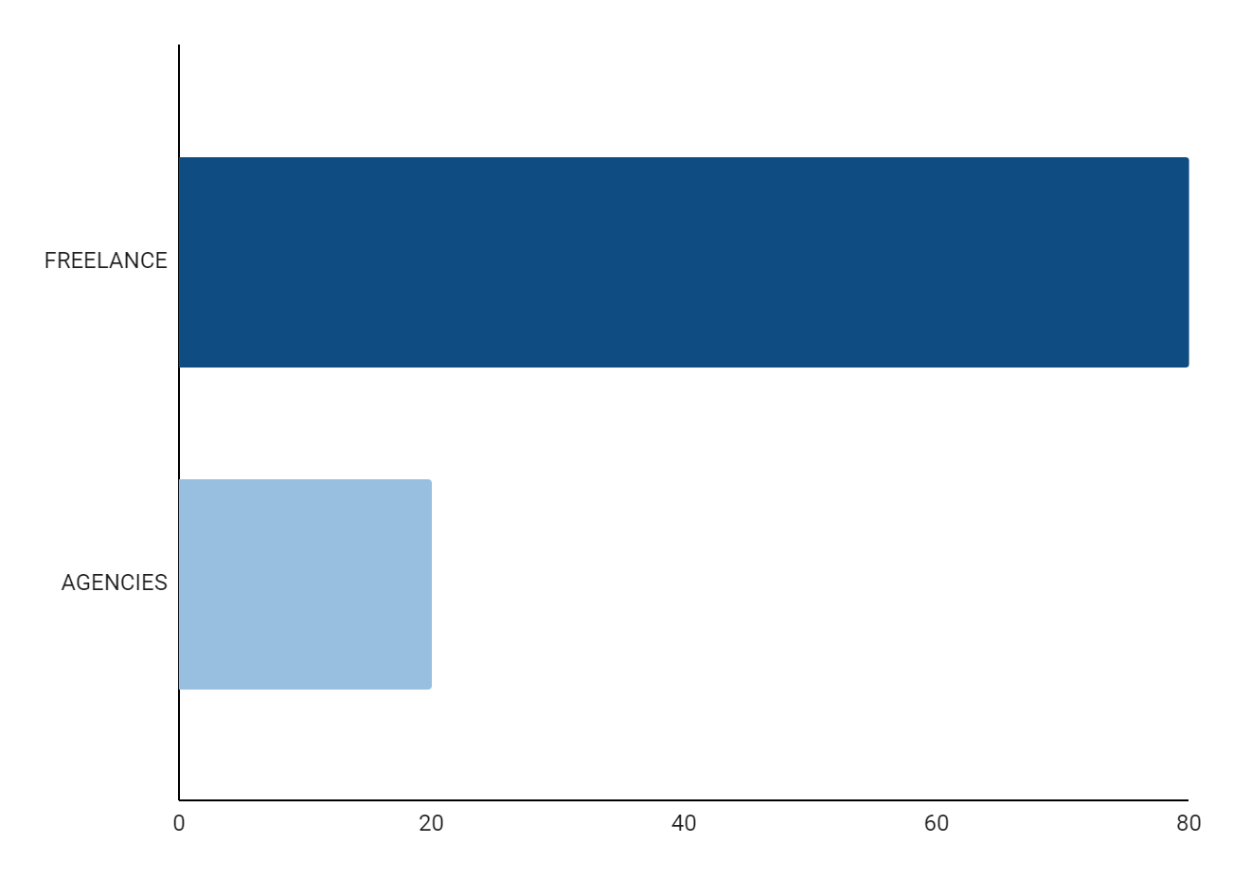
GRAPHIC DESIGN PROJECT PROPOSAL INFOGRAPHICS
80%
FREELANCE
Mercury is the smallest planet
20%
AGENCIES
Jupiter is the biggest planet
Follow the link in the graph to modify its data and then paste the new one here. For more info, click here

Slide 24
GRAPHIC DESIGN PROJECT PROPOSAL INFOGRAPHICS
Venus has a beautiful name but is hot
STEP 1
STEP 2
Earth is the third planet from the Sun
Jupiter is a gas giant and the biggest planet
STEP 3
STEP 4
Neptune is the farthest planet from the Sun
Mercury is the closest planet to the Sun
STEP 5

Slide 25
GRAPHIC DESIGN PROJECT PROPOSAL INFOGRAPHICS
PROBLEM
Mercury is a small planet
Venus has a beautiful name
BRAINSTORMING
Saturn has several rings
The Moon is a small satellite
DISCARD
Mars is a very cold planet
Earth is the planet with life

Slide 26
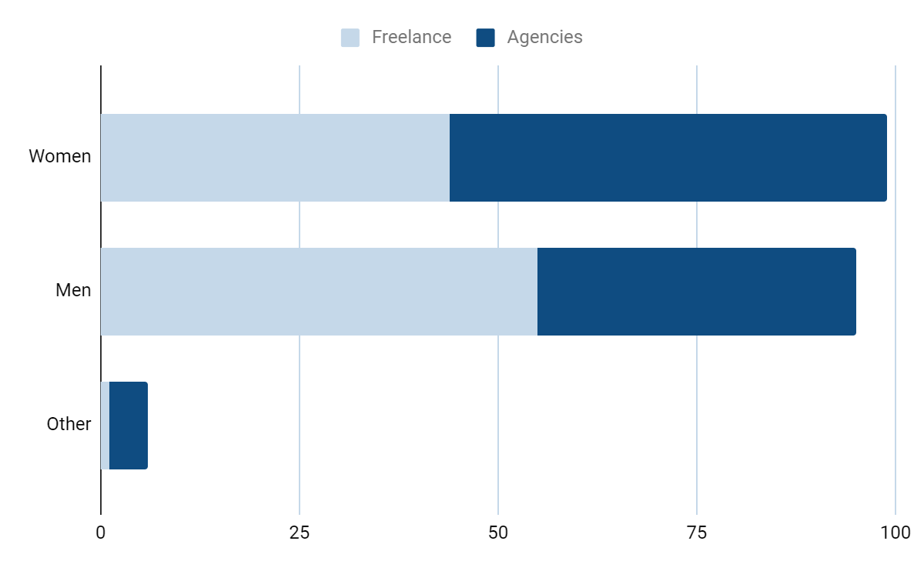
GRAPHIC DESIGN PROJECT PROPOSAL INFOGRAPHICS
FREELANCE
Saturn is a gas giant and has several rings
AGENCIES
Venus has a beautiful name but is hot
Follow the link in the graph to modify its data and then paste the new one here. For more info, click here

Slide 27
GRAPHIC DESIGN PROJECT PROPOSAL INFOGRAPHICS
MONTHLY WORK PLAN
MON | TUE | WED | THU | FRI | SAT | SUN
 |  |  |  |  | 1 | 2
3 | 4 | 5 | 6 | 7 | 8 | 9
10 | 11 | 12 | 13 | 14 | 15 | 16
17 | 18 | 19 | 20 | 21 | 22 | 23
24 | 25 | 26 | 27 | 28 | 29 | 30
Mercury is the closest planet to the Sun and the smallest one in the Solar System—it’s only a bit larger than the Moon
START
CHANGES
DEADLINE

Slide 28
GRAPHIC DESIGN PROJECT PROPOSAL INFOGRAPHICS
BUYER PERSONA
HOBBIES
Age:
18-40
Gender:
Woman
Location:
Europe
Studies:
Marketing
Level:
Gradee
Marital Status:
Single
Occupation:
Freelance
Arts
Music
Income Range:
$1500-$2000
Books
Films

Slide 29
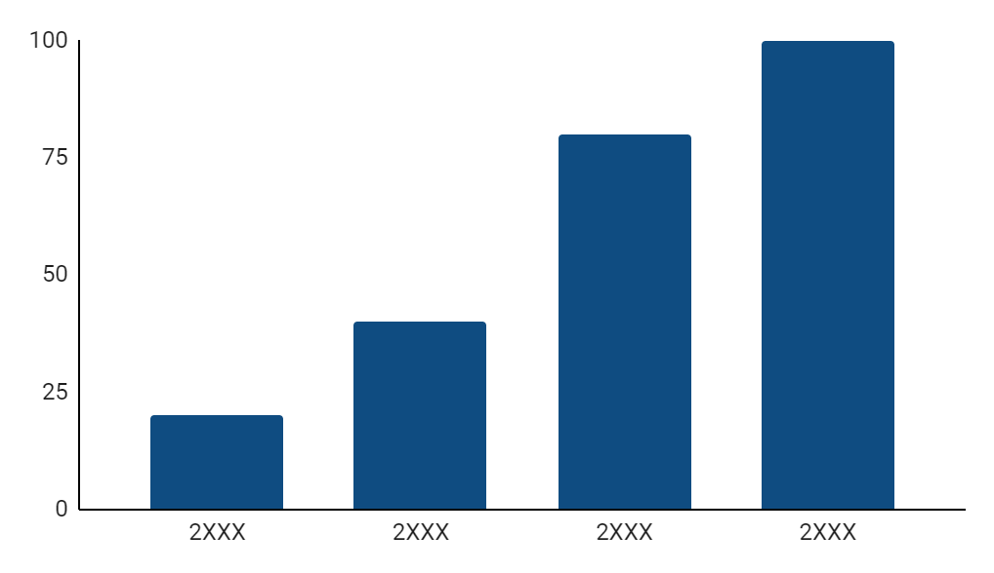
GRAPHIC DESIGN PROJECT PROPOSAL INFOGRAPHICS
2XXX
Saturn is a gas giant with rings
2XXX
Venus has a beautiful name
2XXX
Jupiter is a gas giant
2XXX
Follow the link in the graph to modify its data and then paste the new one here. For more info, click here
Earth is the third planet

Slide 30

GRAPHIC DESIGN PROJECT PROPOSAL INFOGRAPHICS
PRINCIPAL GOALS
BUYER PERSONA
AGE AND GENDER
Culture diffusion
25 years old, Woman
OCCUPATION
Arts
Graphic designer
Employee rights
MONTHLY SALARY
$1500-$2000 /month

Slide 31

GRAPHIC DESIGN PROJECT PROPOSAL INFOGRAPHICS
PHONES
Mercury is the closest planet to the Sun
SCREENS
TABLETS
Jupiter is a gas giant and the biggest planet
Venus has a beautiful name but is hot

Slide 32

GRAPHIC DESIGN PROJECT PROPOSAL INFOGRAPHICS
Venus has a beautiful name but is hot
ROB
Jupiter is a gas giant and the biggest planet
SHANNON
Mercury is the closest planet to the Sun
JIM

Slide 33
Instructions for use
If you have a free account, in order to use this template, you must credit Slidesgo in your final presentation. Please refer to the next slide to read the instructions for premium users.
As a Free user, you are allowed to:
- Modify this template.
- Use it for both personal and commercial projects.
You are not allowed to:
- Sublicense, sell or rent any of Slidesgo Content (or a modified version of Slidesgo Content).
- Distribute Slidesgo Content unless it has been expressly authorized by Slidesgo.
- Include Slidesgo Content in an online or offline database or file.
- Offer Slidesgo templates (or modified versions of Slidesgo templates) for download.
- Acquire the copyright of Slidesgo Content.
For more information about editing slides, please read our FAQs or visit our blog:
https://slidesgo.com/faqs and https://slidesgo.com/slidesgo-school

Slide 34
Instructions for use (premium users)
As a Premium user, you can use this template without attributing Slidesgo.
You are allowed to:
Modify this template.
Use it for both personal and commercial purposes.
Share this template in an editable format with people who are not part of your team.
You are not allowed to:
Sublicense, sell or rent this Slidesgo Template (or a modified version of this Slidesgo Template).
Distribute this Slidesgo Template (or a modified version of this Slidesgo Template) or include it in a database or in any other product or service that offers downloadable images, icons or presentations that may be subject to distribution or resale.
Use any of the elements that are part of this Slidesgo Template in an isolated and separated way from this Template.
Register any of the elements that are part of this template as a trademark or logo, or register it as a work in an intellectual property registry or similar.
For more information about editing slides, please read our FAQs or visit our blog:
https://slidesgo.com/faqs and https://slidesgo.com/slidesgo-school

Slide 35
Infographics
You can add and edit some infographics to your presentation to present your data in a visual way.
Choose your favourite infographic and insert it in your presentation using Ctrl C + Ctrl V or Cmd C + Cmd V in Mac.
Select one of the parts and ungroup it by right-clicking and choosing “Ungroup”.
Change the color by clicking on the paint bucket.
Then resize the element by clicking and dragging one of the square-shaped points of its bounding box (the cursor should look like a double-headed arrow). Remember to hold Shift while dragging to keep the proportions.
Group the elements again by selecting them, right-clicking and choosing “Group”.
Repeat the steps above with the other parts and when you’re done editing, copy the end result and paste it into your presentation.
Remember to choose the “Keep source formatting” option so that it keeps the design. For more info, please visit our blog.

